Slide 1
Algorithms and Data Structures
Lecture II
Simonas Šaltenis
Nykredit Center for Database Research
Aalborg University
simas@cs.auc.dk

Slide 2
This Lecture
Binary search
Correctness of algorithms
Growth of functions and asymptotic notation
Some basic math revisited

Slide 3
Searching in a Sorted Array
INPUT
sorted non-descending sequence of numbers (database)
a single number (query)
OUTPUT
an index of the found number or NIL
a₁, a₂, a₃,….,a_{n}; q
j
2 4 5 7 10; 5
2
2 4 5 7 10; 9
NIL

Slide 4
Binary search
Idea: Divide and conquer, one of the key design techniques
INPUT: A[1..n] – a sorted (non-decreasing) array of integers, q – an integer.
OUTPUT: an index j such that A[j] = q. NIL, if ∀j (1≤j≤n): A[j] ≠ q
left←1
right←n
do
j←(left+right)/2
if A[j]=q then return j
else if A[j]>q then right←j-1
else left=j+1
while left<=right
return NIL

Slide 5
Binary search – analysis
How many times the loop is executed:
  With each execution the difference between left and right is cult in half
    Initially the difference is n
    The loop stops when the difference becomes 0
  How many times do you have to cut n in half to get 1?
  lg n

Slide 6
Correctness of Algorithms
The algorithm is correct if for any legal input it terminates and produces the desired output.
Automatic proof of correctness is not possible
But there are practical techniques and rigorous formalisms that help to reason about the correctness of algorithms

Slide 7
Partial and Total Correctness
  Partial correctness
IF this point is reached,
THEN this is the desired output
Any legal input
Algorithm
Output
  Total correctness
INDEED this point is reached,
AND this is the desired output
Any legal input
Algorithm
Output

Slide 8
Assertions
To prove partial correctness we associate a number of assertions (statements about the state of the execution) with specific checkpoints in the algorithm.
  E.g., A[1], …, A[k] form an increasing sequence
Preconditions – assertions that must be valid before the execution of an algorithm or a subroutine
Postconditions – assertions that must be valid after the execution of an algorithm or a subroutine

Slide 9
Loop Invariants
Invariants – assertions that are valid any time they are reached (many times during the execution of an algorithm, e.g., in loops)
We must show three things about loop invariants:
  Initialization – it is true prior to the first iteration
  Maintenance – if it is true before an iteration, it remains true before the next iteration
  Termination – when loop terminates the invariant gives a useful property to show the correctness of the algorithm

Slide 10
Example of Loop Invariants (1)
Invariant: at the start of each for loop, A[1…j-1] consists of elements originally in A[1…j-1] but in sorted order
for j=2 to length(A)
do key=A[j]
i=j-1
while i>0 and A[i]>key
do A[i+1]=A[i]
i--
A[i+1]:=key

Slide 11
Example of Loop Invariants (2)
Invariant: at the start of each for loop, A[1…j-1] consists of elements originally in A[1…j-1] but in sorted order
for j=2 to length(A)
do key=A[j]
i=j-1
while i>0 and A[i]>key
do A[i+1]=A[i]
i--
A[i+1]:=key
Initialization: j = 2, the invariant trivially holds because A[1] is a sorted array ☺

Slide 12
Example of Loop Invariants (3)
Invariant: at the start of each for loop, A[1…j-1] consists of elements originally in A[1…j-1] but in sorted order
for j=2 to length(A)
do key=A[j]
i=j-1
while i>0 and A[i]>key
do A[i+1]=A[i]
i--
A[i+1]:=key
Maintenance: the inner while loop moves elements A[j-1], A[j-2], …, A[j-k] one position right without changing their order. Then the former A[j] element is inserted into k-th position so that A[k-1] ≤ A[k] ≤ A[k+1].
  A[1…j-1] sorted + A[j] → A[1…j] sorted

Slide 13
Example of Loop Invariants (4)
Invariant: at the start of each for loop, A[1…j-1] consists of elements originally in A[1…j-1] but in sorted order
for j=2 to length(A)
do key=A[j]
i=j-1
while i>0 and A[i]>key
do A[i+1]=A[i]
i--
A[i+1]:=key
Termination: the loop terminates, when j=n+1. Then the invariant states: “A[1…n] consists of elements originally in A[1…n] but in sorted order” ☺

Slide 14
Asymptotic Analysis
Goal: to simplify analysis of running time by getting rid of ”details”, which may be affected by specific implementation and hardware
  like “rounding”: 1,000,001 ≈ 1,000,000
  3n² ≈ n²
Capturing the essence: how the running time of an algorithm increases with the size of the input in the limit.
  Asymptotically more efficient algorithms are best for all but small inputs

Slide 15



Asymptotic Notation
The “big-Oh” O-Notation
  asymptotic upper bound
  f(n) = O(g(n)), if there exists constants c and n₀, s.t. f(n) ≤ c g(n) for n ≥ n₀
  f(n) and g(n) are functions over non-negative integers
Used for worst-case analysis
Running Time
Input Size

Slide 16
Asymptotic Notation (2)
The “big-Omega” Ω−Notation
  asymptotic lower bound
  f(n) = Ω(g(n)) if there exists constants c and n₀, s.t. c g(n) ≤ f(n) for n ≥ n₀
Used to describe best-case running times or lower bounds of algorithmic problems
  E.g., lower-bound of searching in an unsorted array is Ω(n).
Running Time
Input Size

Slide 17
Asymptotic Notation (3)
Simple Rule: Drop lower order terms and constant factors.
  50 n log n is O(n log n)
  7n - 3 is O(n)
  8n² log n + 5n² + n is O(n² log n)
Note: Even though (50 n log n) is O(n⁵), it is expected that such an approximation be of as small an order as possible

Slide 18


Asymptotic Notation (4)
The “big-Theta” Θ−Notation
  asymptoticly tight bound
  f(n) = Θ(g(n)) if there exists constants c₁, c₂, and n₀, s.t. c₁ g(n) ≤ f(n) ≤ c₂ g(n) for n ≥ n₀
f(n) = Θ(g(n)) if and only if f(n) = Ο(g(n)) and f(n) = Ω(g(n))
O(f(n)) is often misused instead of Θ(f(n))
Running Time
Input Size

Slide 19
Asymptotic Notation (5)
Two more asymptotic notations
  "Little-Oh" notation f(n)=o(g(n))
  non-tight analogue of Big-Oh
    For every c, there should exist n₀ , s.t. f(n) ≤ c g(n) for n ≥ n₀
    Used for comparisons of running times. If f(n)=o(g(n)), it is said that g(n) dominates f(n).
  "Little-omega" notation f(n)=ω(g(n))
  non-tight analogue of Big-Omega

Slide 20
Asymptotic Notation (6)
Analogy with real numbers
  f(n) = O(g(n)) ≅f ≤ g
  f(n) = Ω(g(n)) ≅f ≥ g
  f(n) = Θ(g(n)) ≅f = g
  f(n) = o(g(n)) ≅f < g
  f(n) = ω(g(n)) ≅f > g
Abuse of notation: f(n) = O(g(n)) actually means f(n) ∈O(g(n))

Slide 21
Comparison of Running Times
Running Time | Maximum problem size (n)
 | 1 second | 1 minute | 1 hour
400n | 2500 | 150000 | 9000000
20n log n | 4096 | 166666 | 7826087
2n² | 707 | 5477 | 42426
n⁴ | 31 | 88 | 244
2^{n} | 19 | 25 | 31

Slide 22
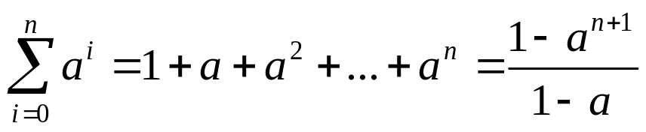
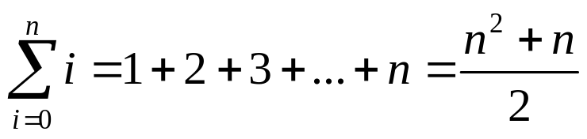
A Quick Math Review
Geometric progression
  given an integer n₀ and a real number 0< a ≠ 1
  geometric progressions exhibit exponential growth
Arithmetic progression

Slide 23
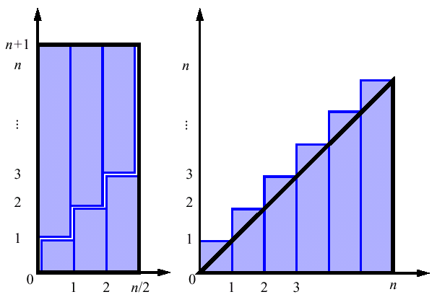
A Quick Math Review (2)

Slide 24
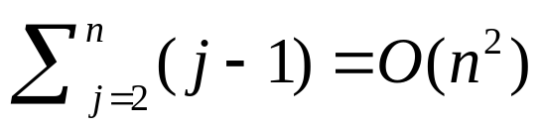
Summations
The running time of insertion sort is determined by a nested loop
Nested loops correspond to summations
for j←2 to length(A)
key←A[j]
i←j-1
while i>0 and A[i]>key
A[i+1]←A[i]
i←i-1
A[i+1]←key

Slide 25
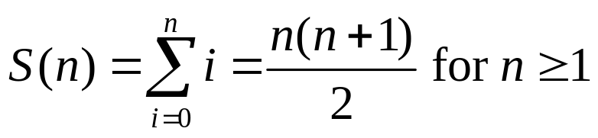
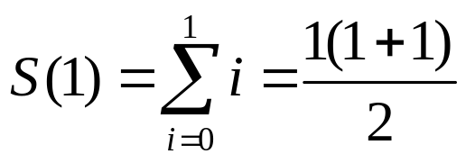
Proof by Induction
We want to show that property P is true for all integers n ≥ n₀
Basis: prove that P is true for n₀
Inductive step: prove that if P is true for all k such that n₀ ≤ k ≤ n – 1 then P is also true for n
Example
Basis

Slide 26
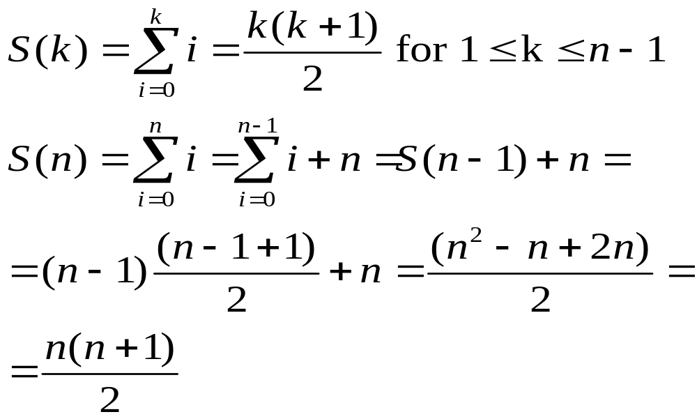
Proof by Induction (2)
Inductive Step

Slide 27
Next Week
Divide-and-conquer, Merge sort
Writing recurrences to describe the running time of divide-and-conquer algorithms and solving them.

